Slide 1


GaME OF LIFE
TEAM : SATHI
MEMBERS:BAO TRAN, BhagyashreeARAS, SUPRAJA AMRUTHA, MIA LEE

Slide 2
Twist to game

Slide 3
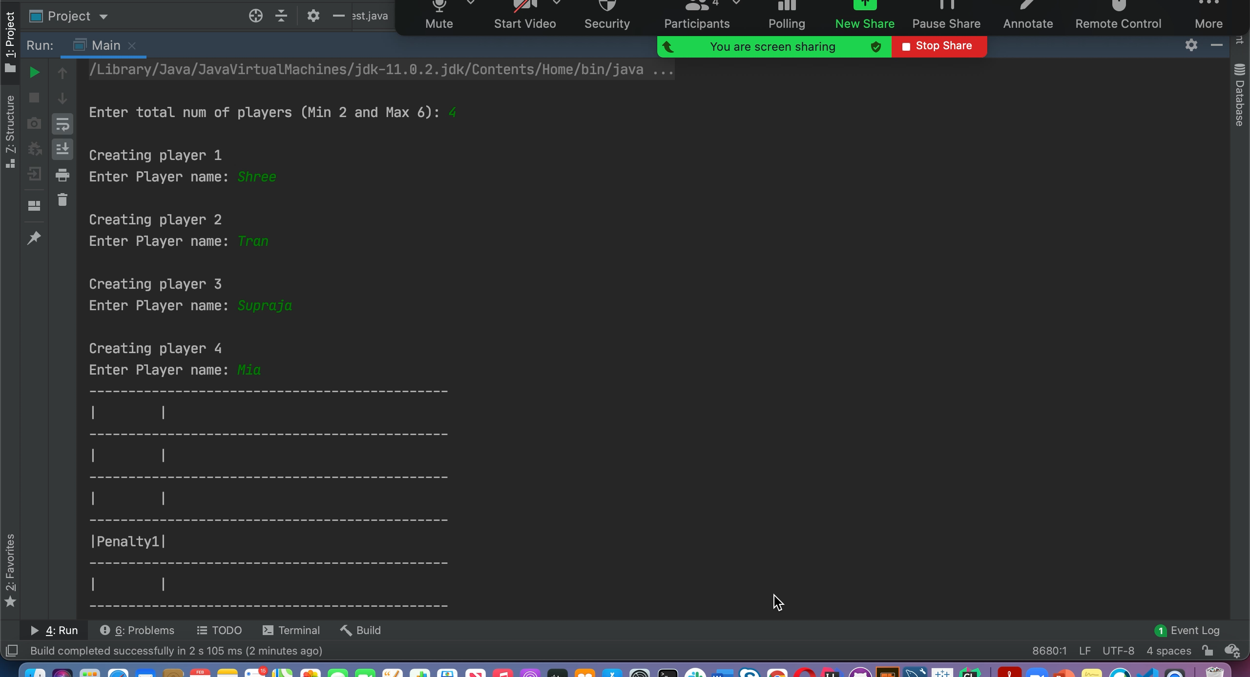
DEMO

